Slide 1

DOSM DATATHON 2026
Geopolitical Risk and
International Tourism
Demand in Malaysia
A machine learning forecasting framework for 20 source markets
TEAM NEXORA
Chin William, Tang Xin Yi, Janis Ong Jing Yao, Tee Xin Yee
Guided by Dr. Kelwin Tan Seen Tiong
Notes:
Timing: 0:00-0:40
Good morning. We are Team Nexora: Chin William, Tang Xin Yi, Janis Ong Jing Yao and Tee Xin Yee. Our project asks how geopolitical risk relates to international tourism demand in Malaysia, and turns that question into a one-to-four-month forecasting framework for 20 source markets.
Cover image: OpenAI ImageGen, generated for this presentation in 2026. This is a conceptual composite, not documentary photography.
Project title and team details: report/Nexora_Datathon2026_Report.docx.

Slide 2
The planning gap is market-level visibility
02
How does geopolitical risk affect tourism demand in Malaysia?
RESEARCH OBJECTIVES
01
Traceable data
National totals can hide source markets that move in different directions, limiting the lead time for marketing, capacity and workforce decisions.
Integrate arrivals with exchange rates, energy prices and geopolitical risk.
02
Short-term forecasting
Predict each source market one to four months ahead.
15.9%
3.7M
03
Decision support
of GDP from tourism industries in 2025
tourism-related jobs in 2025
Show market differences and model reliability in Power BI.
Notes:
Timing: 0:40-1:30
Tourism generated 15.9 percent of GDP and supported 3.7 million jobs in 2025. Yet national totals do not tell planners whether weakness is broad or concentrated in particular source markets.
Our objectives are to build a traceable monthly panel, forecast each market one to four months ahead, and communicate the results through a self-contained dashboard.
Source: Department of Statistics Malaysia, Tourism Satellite Account 2025, cited in report/Nexora_Datathon2026_Report.docx, sections 1.1 and 1.3. https://www.dosm.gov.my/portal-main/release-content/tourism-satellite-account-2025

Slide 3
Data and forecasting framework
03
20
2,300
19 + 1
80
source markets
country-months
numeric and categorical inputs
live forecast rows
SIGNALS USED
Arrivals history
Affordability
Transport cost
Risk
Origin value, lags, rolling means and seasonality
Monthly bilateral MYR exchange rates
Brent crude and Malaysian fuel prices
Global and Malaysia geopolitical risk indices
One pooled, direct multi-horizon LightGBM predicts every market at 1, 2, 3 and 4 months ahead.
Notes:
Timing: 1:30-2:30
We collapsed repeated daily storage rows to their true country-month grain: 20 markets across 115 months, or 2,300 observations. June to September 2026 form 80 genuine forecast rows and never enter training or evaluation.
The model combines recent demand, bilateral exchange rates, energy prices and two GPR indices. One pooled direct LightGBM shares information across short country series and predicts each horizon directly, which avoids recursive error propagation.
Sources: docs/METHODOLOGY.md sections 1 to 3; report/Nexora_Datathon2026_Report.docx sections 3.1 to 3.5; machine_learning/config.py.

Slide 4
Validation mirrors each historical forecast date
04
01
Publication-lag alignment
Each predictor uses the freshest month that would have been released at the forecast date.
02
Rolling-origin backtest
Five post-recovery origins test horizons 1 to 4 with a row-level no-future-information rule.
03
Separate shock test
Five COVID and reopening origins reveal performance under an extreme structural break.
04
Scale-aware metrics
MAE and RMSE avoid unstable percentage errors in small-volume markets.
Training excludes every target that was unpublished at the simulated forecast date.
Notes:
Timing: 2:30-3:30
The main credibility issue is information timing. For each historical forecast, we cap every input at the month that would actually have been available. We also exclude any training row whose target had not yet been published.
Five normal-period origins provide the primary comparison. Five COVID and reopening origins remain separate because they represent a different regime. We report MAE and RMSE by horizon and avoid MAPE because near-zero months distort percentage errors for small markets.
Source: docs/METHODOLOGY.md sections 3 to 4; report/Nexora_Datathon2026_Report.docx sections 3.5 and 3.6.

Slide 5
LightGBM minimizes total error across all horizons
05
15,969
aggregate MAE
Horizon detail
LightGBM leads at months 1 and 2. Seasonal-naive leads narrowly at month 3. Ridge leads narrowly at month 4.
The pooled criterion matches the single model used in deployment.
Notes:
Timing: 3:30-4:30
Across every primary backtest prediction, LightGBM has the lowest aggregate MAE at 15,969 arrivals. Ridge is close at 16,727, followed by naive-last and seasonal-naive.
The result needs nuance. LightGBM leads at horizons one and two. Seasonal-naive is marginally best at horizon three, while Ridge is marginally best at horizon four. Those later-horizon gaps are small enough that switching models could fit fold noise, so we deploy one pooled LightGBM.
Source: machine_learning/README.md; machine_learning/outputs/backtest_accuracy_by_horizon.csv; report/Nexora_Datathon2026_Report.docx section 4.1.

Slide 6
Forecast softens after July across the 20 markets
06
10.2%
decline from the July peak to September
June leaders
Singapore leads at 0.99M. China and Indonesia follow at 0.36M and 0.31M.
Point forecasts only. The current model does not produce prediction intervals.
Notes:
Timing: 4:30-5:30
Across the 20 modelled markets, arrivals remain near 2.28 million in June and July, then soften to 2.17 million in August and 2.05 million in September. That is a 10.2 percent decline from the July peak.
Singapore is the largest June forecast at 994,700 arrivals, followed by China and Indonesia. These are point forecasts for the tracked markets only. They are not a national total, and the current version does not provide prediction intervals.
Source: machine_learning/outputs/forecast_future_2026.csv; report/Nexora_Datathon2026_Report.docx section 4.2.

Slide 7
GPR associations differ sharply by source market
07
16 of 20
markets have a negative controlled slope
Interpretation
The direction changes after controlling for demand history, seasonality, exchange rates and energy prices.
These are model associations, not causal effects.
Notes:
Timing: 5:30-6:40
The controlled Ridge slopes show strong market heterogeneity. Sixteen of 20 markets are negative. Singapore, Indonesia and China are positive, while Thailand is approximately neutral.
The raw pooled correlation is weakly positive, but the controlled slope is negative for most markets after accounting for demand history, seasonality, exchange rates and energy prices. The sign change may reflect shared time trends and correlated predictors.
These are associations inside the model. They do not prove that geopolitical risk caused arrival changes.
Source: machine_learning/outputs/gpr_country_ridge_interaction.csv; docs/METHODOLOGY.md section 7; report/Nexora_Datathon2026_Report.docx section 4.2.

Slide 8
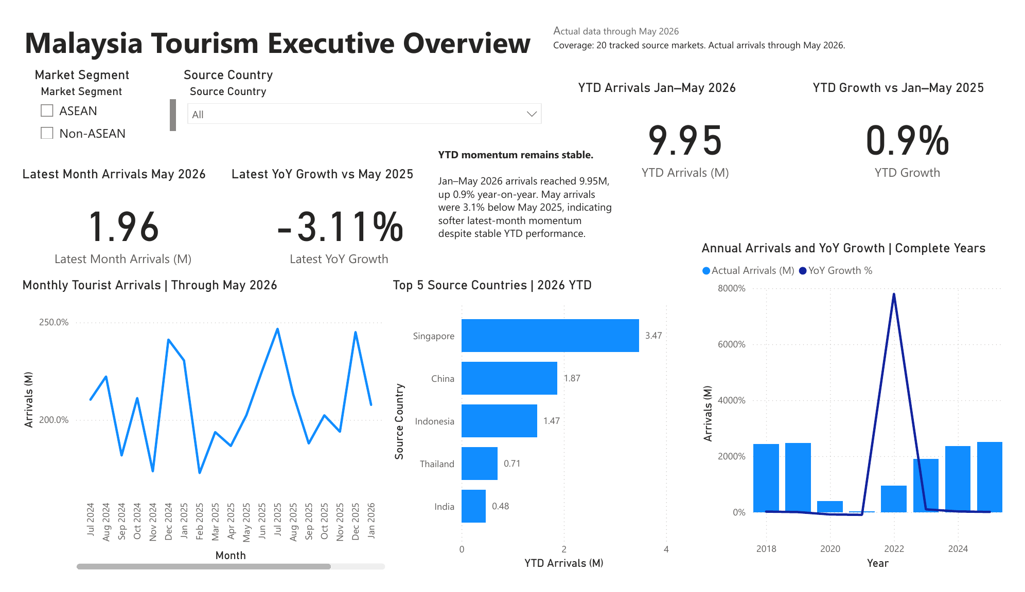
Live dashboard demonstration
08
DEMO PATH
01
Filter market segment and source country
02
Click a visual to cross-filter the page
03
Hover for monthly FX, Brent and GPR
04
Open Forecast to compare models and stress tests
Native Power BI visuals with no external add-ons
Notes:
Timing: 6:40-9:00
Switch to the live Power BI file for this segment.
1. Start on Malaysia Tourism Overview. Change Market Segment from All to ASEAN, then select one source country. Point out that every linked visual updates.
2. Click the Top 5 source-country bar chart to demonstrate cross-filtering, then clear the selection.
3. Open Tourism Drivers. Select a source country and hover over a point to show arrivals together with FX, Brent and GPR context. State that these charts show co-movement, not causality.
4. Open Forecast. Show June to September predictions, MAE by horizon, the COVID stress test and lag sensitivity. Explain that lower MAE is better and that naive persistence wins during the COVID shock.
5. End by returning to the Overview page and clearing filters.
Dashboard source: powerbi_dashboard/Dashboard.pbix and powerbi_dashboard/Dashboard.pdf. User guide: powerbi_dashboard/README.txt.

Slide 9
Market-level forecasts support earlier, more targeted decisions
FORECAST
Arrivals stay near 2.28M in June and July, then soften toward September.
RISK
GPR associations vary across markets, while extreme shocks can overwhelm every model.
SCALE
Monthly retraining, prediction intervals and wider market coverage extend the framework.
Thank you
TEAM NEXORA
Notes:
Timing: 9:00-9:40
The operational value is earlier market-level visibility. Our forecast suggests stable arrivals in June and July before softer demand through September. The risk analysis shows that market responses differ and that extreme shocks can dominate model patterns.
The framework can scale through a monthly data refresh and retraining cycle. The next technical priority is prediction intervals, followed by wider market coverage and additional shock scenarios.
Close by restating the scope: 20 modelled markets, one-to-four-month forecasts, and a self-contained Power BI dashboard.
Sources: report/Nexora_Datathon2026_Report.docx section 6; machine_learning/README.md; powerbi_dashboard/README.txt.

